Slide 1
Startup Assignment
Mekala Rohith Yadav – S20220010136 Mudavath Shashank Chauhan – S20220010142 Doddipatla Rushikeswar – S20220010063

Slide 2
Startup Idea
A platform for students to access expensive equipment temporarily.
Solves affordability and availability issues.

Slide 3
Problem Statement
High cost of gadgets
Limited lab access
Unreliable borrowing
Underutilized resources

Slide 4
Magic Triangle - Customer
College students
Hackathon participants
Freelancers
Researchers

Slide 5
Magic Triangle - Problem
Cannot afford equipment
Limited access
No trusted system

Slide 6
Magic Triangle - Solution
Online rental platform
Time-based usage
Secure booking
Community sharing

Slide 7
User Interview Questionnaire
Have you ever needed expensive equipment for short-term use?
Yes, I needed a DSLR camera for a hackathon.
2. Have you faced problems in getting equipment? Yes, the equipment was already booked in the lab.
3. What difficulties do you face (cost, availability, trust)? High cost and limited availability are the main issues.
4. Would you use an online rental platform? Yes, if it is affordable and verified.

Slide 8
User Interview Questionnaire
Have you ever needed expensive equipment for short-term use?
Yes, I needed a 3D printer for my semester project.
2. Have you faced problems in getting equipment? Yes, lab timings were very restricted.
3. What difficulties do you face (cost, availability, trust)? Availability is the main issue, especially during peak project time.
4. Would you use an online rental platform? Yes, if it offers secure payments and proper verification.

Slide 9
User Interview Questionnaire
Have you ever needed expensive equipment for short-term use?
Yes, I required an Arduino kit for a competition.
2. Have you faced problems in getting equipment? Yes, I couldn’t find anyone willing to lend it.
3. What difficulties do you face (cost, availability, trust)? Trust issues while borrowing from others.
4. Would you use an online rental platform? Yes, especially if it has ratings and reviews.

Slide 10
User Interview Questionnaire
Have you ever needed expensive equipment for short-term use?
No, but I may need it for future projects.
2. Have you faced problems in getting equipment? Yes, rental shops near campus are expensive.
3. What difficulties do you face (cost, availability, trust)? High rental cost is the biggest problem.
4. Would you use an online rental platform? Yes, if the prices are affordable for students.

Slide 11
User Interview Questionnaire
Have you ever needed expensive equipment for short-term use?
No, but I may need it for future projects.
2. Have you faced problems in getting equipment? Yes, rental shops near campus are expensive.
3. What difficulties do you face (cost, availability, trust)? High rental cost is the biggest problem.
4. Would you use an online rental platform? Yes, if the prices are affordable for students.

Slide 12
MVP Core Features
1.Login 2.Search 3.Listings 4.Booking
Home
Search bar
Category listing
Booking
Select date
Upload ID
Confirm booking

Slide 13
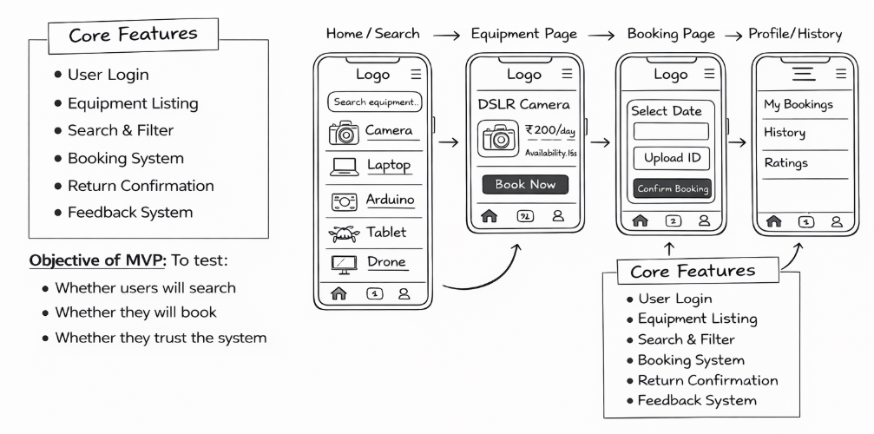
MVP Sketch

Slide 14
Validation Metrics
Sign-ups
Bookings
Repeat users
Feedback
Complaints

Slide 15
Thank You

